Slide 1
LingoLand
Read more. Study less

Slide 2
Roles
Sam Avis
Design Lead
Flashcard Design
Full-Stack Developer
Kristofer Kwan
Full-Stack Developer
Flashcard Maker Workflow
Yuhao Wang
Full-Stack Developer
Suggested Articles Page
Yanshen Lin
Full-Stack Developer
Authentication / Homepage
Philip Chang
Backend Developer
Authentication/ Login

Slide 3
Agenda
1. Problem space
2. Solution
3. App Workflow, Database Diagrams, Tech used
4. How we stand out from our competition
5. The design process
6. Demo
7. What’s next?
Notes:
app is about
trying to solve and how we solve it
earlier mockups
what our sight looks like currently (diagrams)
demonstration
wrap it up by the future

Slide 4
Problem Space
Language learning apps can be clunky and inefficient (sentence mining)
Finding new material
Using new material into a flashcard
They could be better...
Notes:
First point reinforced when we talk about competitors
Sentence mining becomes the most time consuming part of the learning process after a while

Slide 5
Solution:
LingoLand
LingoLand puts a focus on a simple user interface.
It helps you parse through native material and quickly make new flashcards all in one site.
It makes use of an spaced repetition flashcard system to take the burden of deciding what to study off of the user
Lets the user select articles based on topics they are interested in

Slide 6
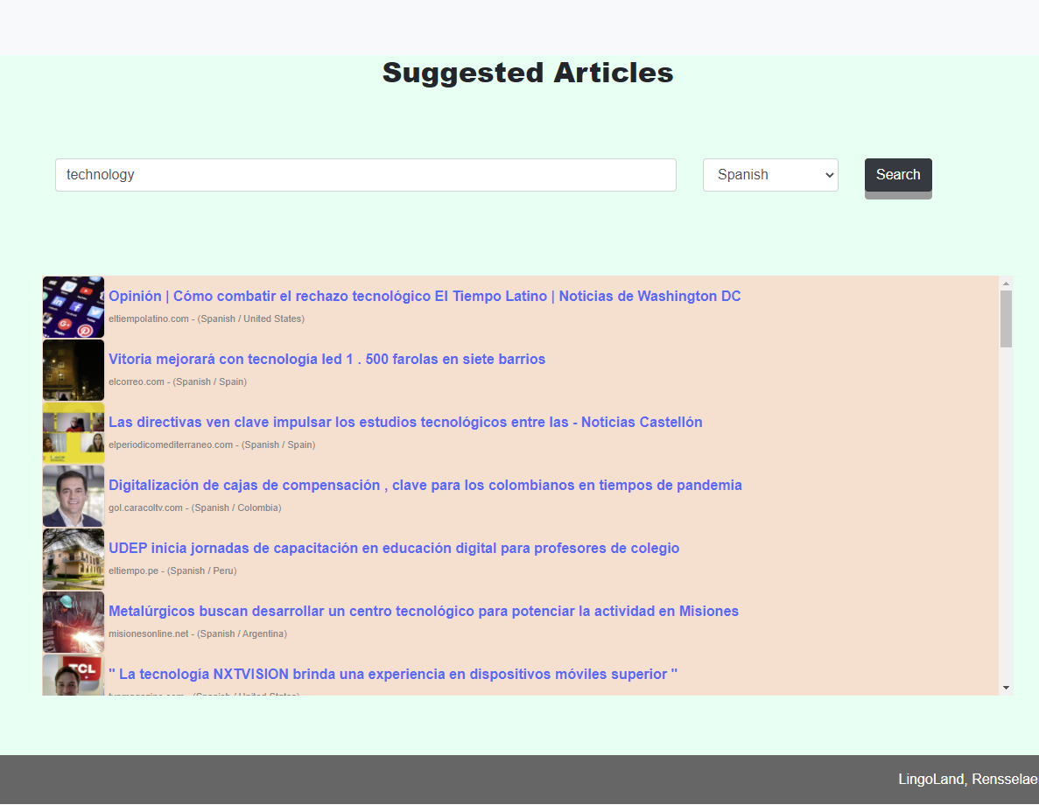
Steve wants to improve his reading literacy in Spanish. He’s decided that he wants to learn via news articles but he doesn’t know where to start.
Instead of going through a general search engine, Steve can use LingoLand’s suggested articles feature. This allows him to search based off of topic and the language he is trying to learn.
The search features allows Steve to find engaging and current articles in the language he’s learning.

Slide 7
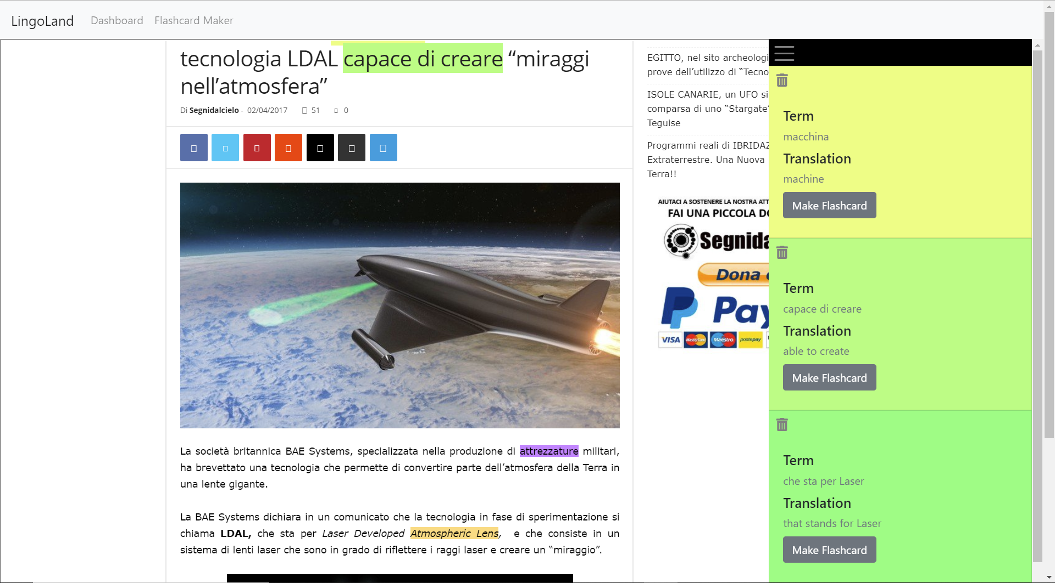
Steve’s found an article that he wants to read and wants to keep track of terms that he doesn’t understand.
No problem, he can go through our site and create highlights directly on an article, as well as save the terms that he wants to remember by creating flashcards.

Slide 8
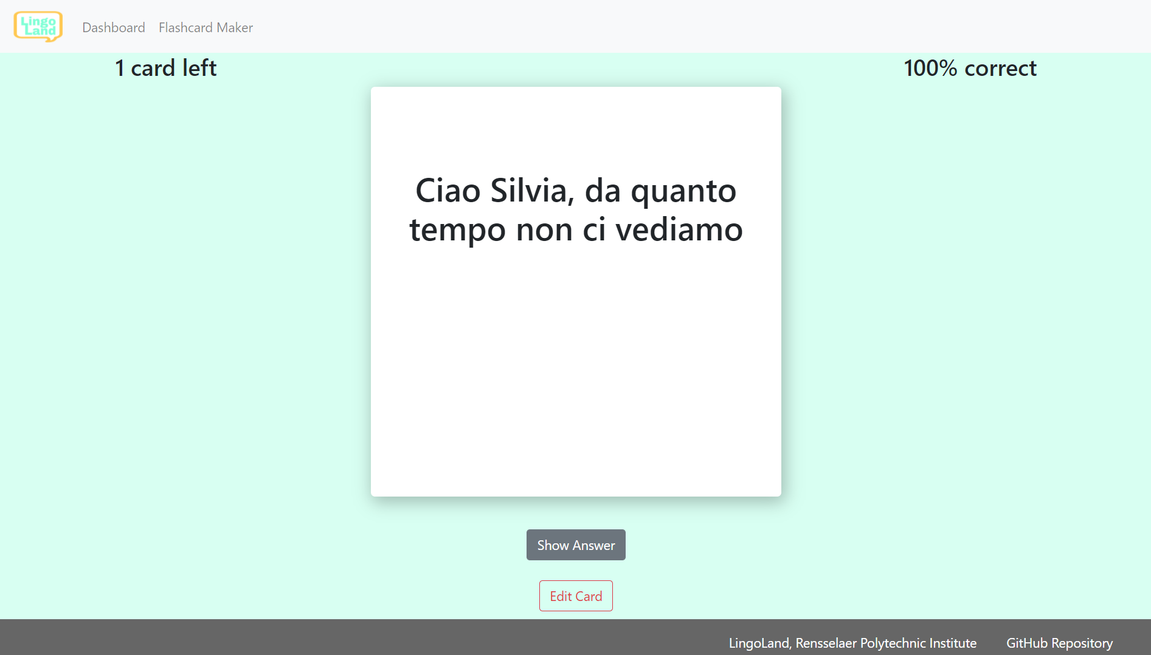
Steve’s has flashcards that he wants to review, but he only wants to review cards he truly does not know
Our site uses an SRS system to show daily cards. Cards that Steve get wrong are prioritized, with more imminent due dates, whereas cards that he gets right more often have later due dates.
In this way, Steve is not overburdened with flashcards to memorize, reducing the amount of time spent per day studying.

Slide 9
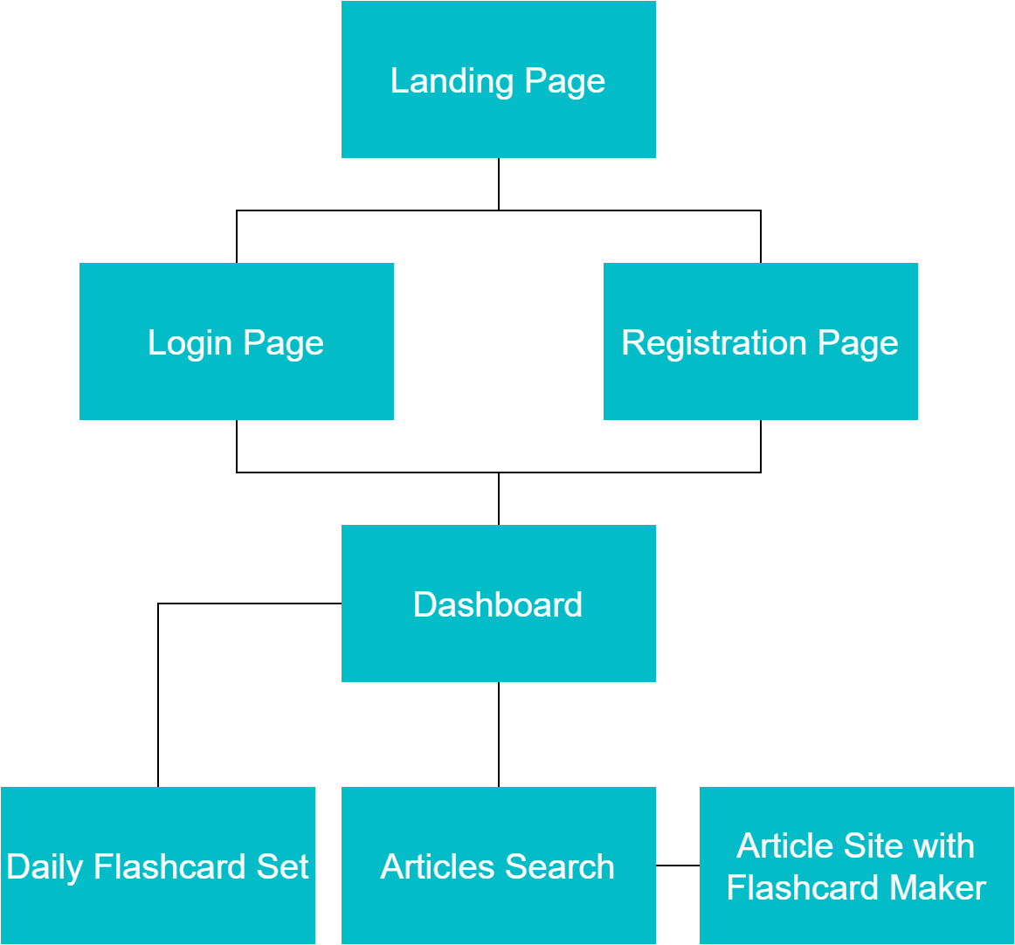
App Workflow
Notes:
Workflow
Users would sign up to our site and have their own dashboard.
From there, they can choose to read articles, in the language that they are trying to learn.
Through our flashcard workflow, they would take sections of an article and highlight specific terms they do not understand. Those highlighted terms would be translated automatically by our site. The user has the option to create flashcards based off the translation (which they can edit manually in the dashboard page later on)
From the user dashboard, the site will have a set of daily flashcards in which the user can go through

Slide 10
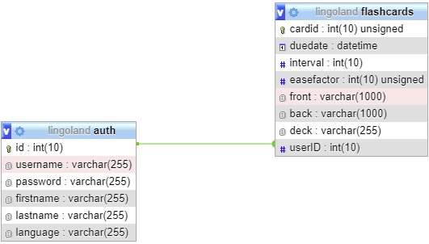
Database Diagram Workflow
Notes:
Database Diagram
Users would sign up to our site and have their own dashboard.
Users have many cards, which are referenced via their userIds.
Flashcards have duedate interval (amount of time when card should appear, easefactor which is used for SRS, deck it belongs in, and the front and back of our card)

Slide 11








Technologies Used
Notes:
As per our project’s requirements, we use the LAMP stack to develop our application. php was used to communicate with the Watson Health Translation API, allowing us to translate from english to other languages. It was also used to interact with the GDELT API, which is what we used to get our news articles based off of language filters. these php endpoints for gdelt and watson health translation are called via JavaScript ajax requests to query for the articles/ translations respectively. php allowed us to query for file contents from various different sites and display them on our own via iframes, thus allowing users to stay on our site and still be able to highlight relevant text in the articles they are reading.
php was also used to host all of our sites, keep track of user authentication and authorization per sites (ie, the user cant access the dashboard page if they are not signed in), as well as querying and inserting into our SQL database flashcard information.
We used bootstrap to design our site pages because of its ease of use as well as bootstrap’s nice design

Slide 12
How We Stand Out
We have simple interface.
Combines all the stages of the learning process
Specific to language learning
Providing specific language articles for users to experience new words in a real world context
Notes:
Should talk about our “competitors” (ie quizlet, and anki)
Quizlet: not designed for language learning, no SRS
Anki: clunky GUI, too many setting create a barrier for new learners
Put emphasis on creating flashcards from articles

Slide 13
Design Process
Notes:
In the design process, We will discuss the flashcard and flashcard maker design for LingoLand.

Slide 14
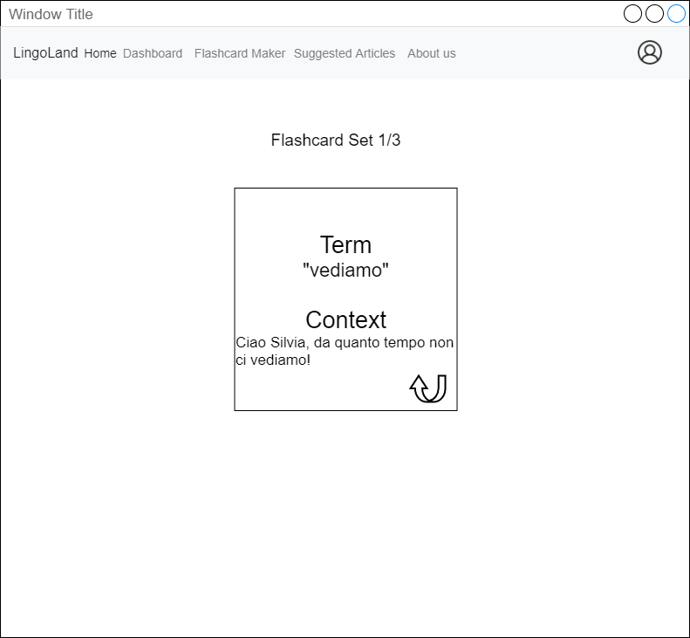
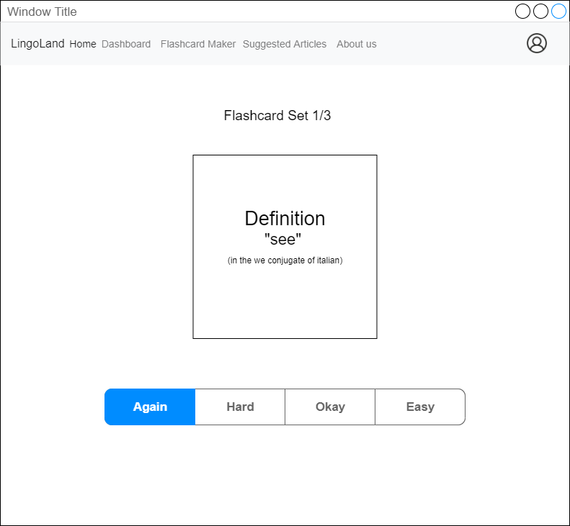
The Draft Flashcard Design
Notes:
This is the draft design of the flashcard, it is very simple, we have two sides on the flashcard like the normal flashcard. One side is the front, and the other sides is back. After users came up with the answers with the original term shown on the front, he can click on the flashcard to view the correct answer shown on the back.

Slide 15
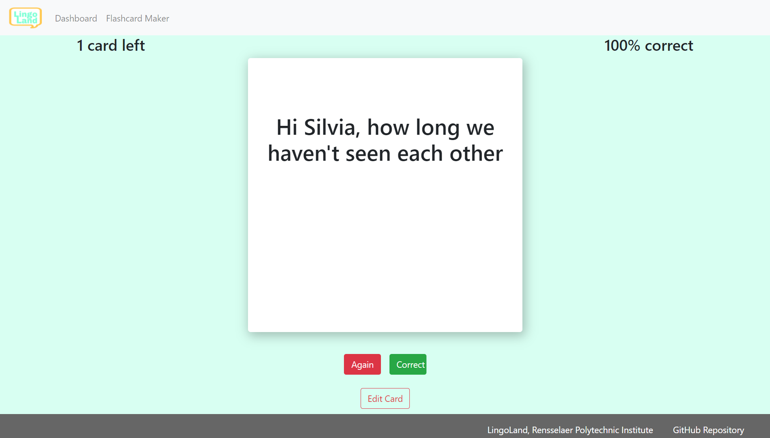
The Final Flashcard Design
Notes:
This is the final design for flashcard. It is working the same way as the draft design. We are keeping the two sides design for flashcard. We provided the front flashcard is the original term, then the translation text will be available to view when you click on “show Answer” button.
when you flip the flashcard over to see the answer, you can either click on correct if you are right, and move to next flashcard; or click on “again” if you are incorrect, which will move the card to the back of the set (and continue to show you the card until you get the answer correct).

Slide 16
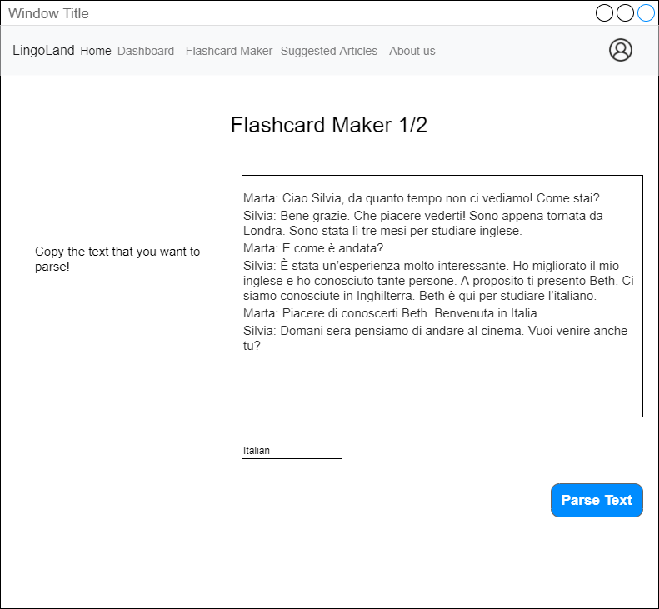
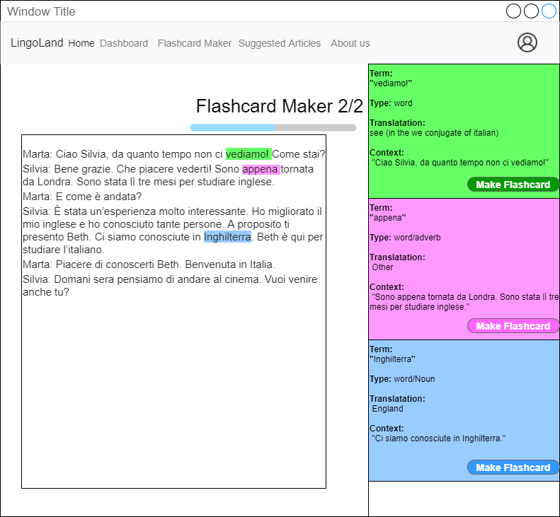
The Draft Flashcard Maker Design
Notes:
At the beginning of our design process for flashcard maker, we want to provide the textarea for users to input their text, so they can highlighting the term from the inputted text and make flashcards off of them, with the term being the word highlighted, and the definition being the translation.

Slide 17
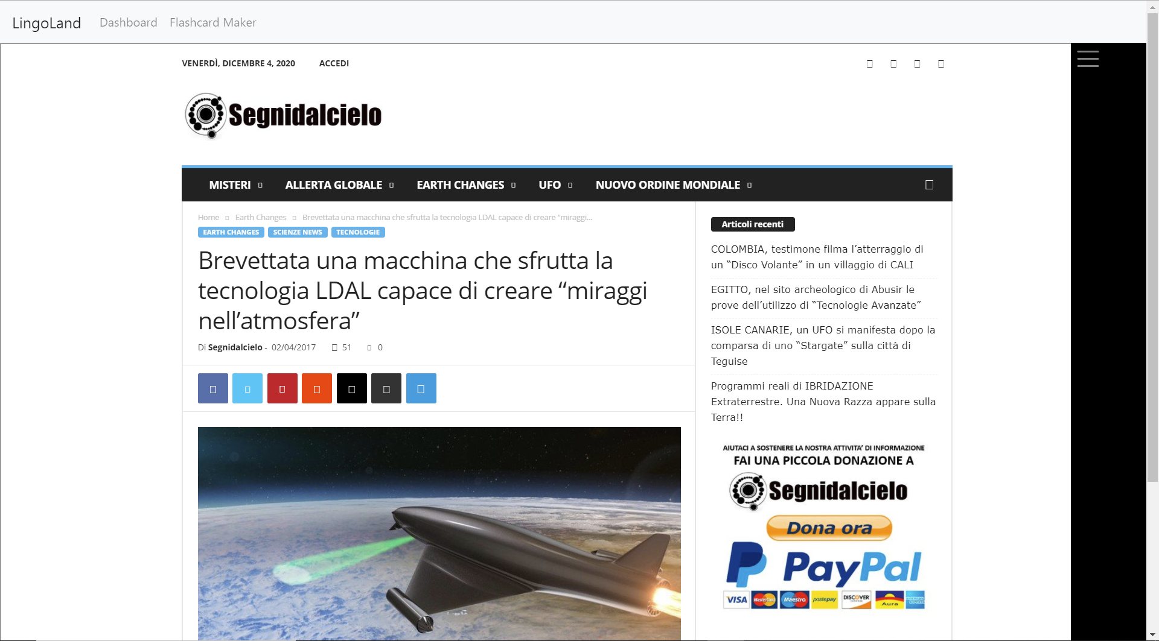
The Final Flashcard Maker design
Notes:
However, in the final version of our flashcard maker design, we providing the suggest articles in the specific learning language for users to parse the term instead of input the texts by users themselves. We believe this will also increase the flexibility and efficiency for users to learning new a language.
Users also able to highlighting words to get translate.
As you see on the image, the translation term will be available on the right sidebar section.

Slide 18
Demo Time.

Slide 19
What’s next?
Provide Profile Customization
Support other languages to learn from.
Goal System (“Add 20 new cards per day”)
Parse article to determine % of words are already in the deck
More statistics options display for users regarding to flashcard’s data.
More flexibility on the platform.
Notes:
Allow users to customize their own profile. We will be develop the theme selection, slogan for each person, and profile image upload, etc.
LingoLand only works for English right now. We want to add more language options for the user to learn from (like spanish to chinese).
Helping users to set up their goal, and our system can help them to reach their goal. For example: “how many flashcard I need to memorize today” “how many words I need to know today” and so on. （Following with the user’s goal, our system will be automatically setup a test from the user’s daily flashcard term, if the user can pass the test, he will done with this goal.
In this feature, we want to make the system more visible for user during adding the new flashcard to the deck. In this case, user are able to see how many percent of words in the article he is already highlighted. So users are able to
We want to provide more statistics for users to see, like bar chart of the learning progress, percent graph to reach the goal. We will provide the the ranking system to make all the statistics of all learner in that one specific language.
We will try to add some features like connect to other learner that learning the same language as you, therefore, you can arrange the test, solve problems, and learn together with other learner. I believe this will increase the learning progress, in the same time, you can make friends during learning.

Slide 20
Questions?
Thank You!

